Slide 1


BCDV 1025
Enterprise Blockchain
2023 February
week 01 - class 02
 | BCDV 1025 Enterprise Blockchain | Pratik Patil

Slide 2
Organization
 | BCDV 1025 Enterprise Blockchain | Pratik Patil

Slide 3
Each participating Real world organization can be defined as an Organization in Hyperledger.
Each organization is joined to a network by adding its Membership Service Provider (MSP) identity to the network.
Each organization setups its own Certificate Authority, Peers and Orderers.
Each organization is uniquely recognized on the network by its MSPId
An organization can also define peers and orderers under different Organization units.
Each organization manages its own Certificate Authority and Peers.
 | BCDV 1025 Enterprise Blockchain | Pratik Patil

Slide 4
Chaincode
 | BCDV 1025 Enterprise Blockchain | Pratik Patil

Slide 5
In the Hyperledger Fabric framework, Smart-Contracts are known as Chaincodes.
Chaincodes are the contract definition agreed upon by the participating organizations.
Chaincodes are executed by the peers after verifying the consensus.
Chaincodes have Three functionalities: Init, Invoke and Query
Init: If the chaincode is the definition which manages its own state, then it first also needs to be initialized.
Invoke: If the chaincode is called which modifies the ledger state, then it must be invoked. Invocation also results in a Transaction creation which would need to comply with the consensus setup.
Query: If the chaincode function is called which only reads the ledger state and does not modify it, then it needs to be queried. The query does not result in a transaction creation.
Chaincodes can be written in: Golang, NodeJs, Typescript and Java
Only peers have access to the Chaincode.
To interact with the Chaincode you can use the Peer CLI and Fabric API.
Each Chaincode transaction is recorded in the ledger.
 | BCDV 1025 Enterprise Blockchain | Pratik Patil

Slide 6
Channel
 | BCDV 1025 Enterprise Blockchain | Pratik Patil

Slide 7
It is a private “subnet” of communication between two or more specific network members, for the purpose of conducting private and confidential transactions.
A channel is defined by members (organizations) and must have the following entities as part of it:
- Peers
- Orderers
- Anchor Peers
- Ledger
Channel can have the Consortium of its members.
A channel must have at least 1 orderer and 1 peer organization.
Channel definition is stored in a file named configtx.yaml
Channel creation transaction can be manually created with configtxgen utility by passing it the configtx.yaml
Each Channel can have multiple chaincodes.
Each channel has its own ledger
Channel definition must be agreed upon by the member organizations.
Channel definitions can be updated.
 | BCDV 1025 Enterprise Blockchain | Pratik Patil

Slide 8
Peers
 | BCDV 1025 Enterprise Blockchain | Pratik Patil

Slide 9
Peer runs and maintains a ledger and chaincode containers in order to perform read/write operations to the ledger.
Peers are owned and maintained by members.
Peers are the clients written Golang.
Peers store the ledger in LevelDB by Default and for the production network it is stored in the CouchDB
If the LevelDB is configured, the data is stored locally.
In the case of CouchDB, the database needs to be configured separately and provides its configuration to the peer.
Peers can have two roles assigned by the Certificate Authority admin or peer.
Peers use the gossip or the grpc protocol for communication.
Each peer has the identity generated by the Certificate Authority in the form of TLS certificates.
Each peer has its configuration stored in the file core.yaml
In the case of the Docker peer image, the configuration of the core.yaml is overwritten by the environment variables.
In each peer, the gateway is configured which allows Fabric API to interact with the peer.
A Peer can be part of multiple channels.
It manages the ledger of different channels in the same database.
 | BCDV 1025 Enterprise Blockchain | Pratik Patil

Slide 10
Types of Peers
Transaction Processing:
1. Endorsing Peers
Endorsing Peers validates the transactions based on the Channel Endorsement policy
Endorsement peers also maintain the Ledgers
Chaincode can be Invoked and Queried only by the Ednorsing Peers
2. Member Peers
Member peers only maintain the channel ledger.
Member peers may or may not have Chaincodes on it.
 | BCDV 1025 Enterprise Blockchain | Pratik Patil

Slide 11
Types of Peers
Channel Management:
1. Anchor Peers
Anchor peer discovers and communicates with all the peers in the channel.
Each organization must have at least 1 Anchor Peer
Anchor Peer also allows peers of the organization to discover the peers of another organization on the same channel.
Anchor Peer can be either Endorsing Peer or a Member Peer
 | BCDV 1025 Enterprise Blockchain | Pratik Patil

Slide 12
Types of Peers
Configuration Management:
Admin Peers
Admin Peers acts as an organization’s representative when updating or modifying the organization's definition or proposing the changes to Channel Consensus.
Admin Peer can be either Endorsing Peer or a Member Peer
 | BCDV 1025 Enterprise Blockchain | Pratik Patil

Slide 13
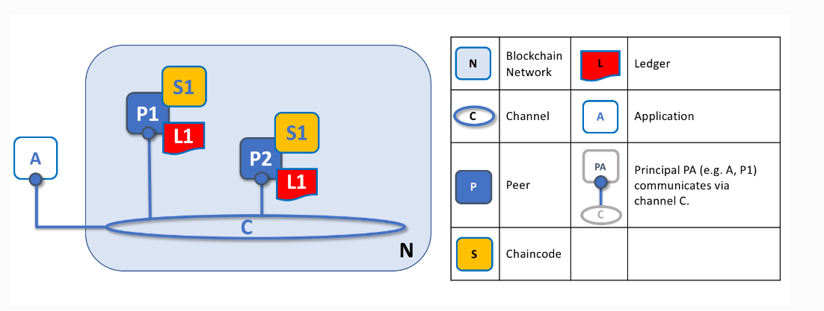
 | BCDV 1025 Enterprise Blockchain | Pratik Patil

Slide 14
Transactions
 | BCDV 1025 Enterprise Blockchain | Pratik Patil

Slide 15
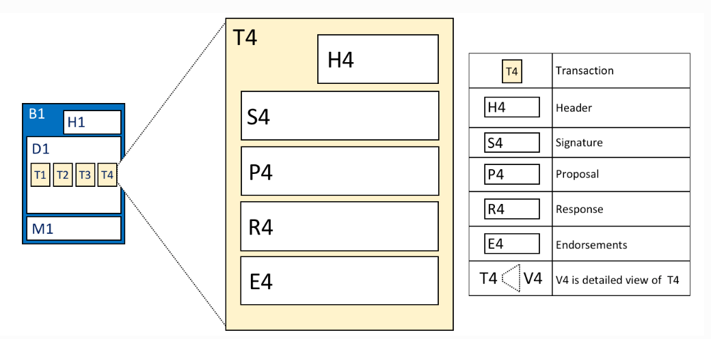
As we’ve seen, a transaction captures changes to the world state. Let’s have a look at the detailed blockdata structure which contains the transactions in a block.
 | BCDV 1025 Enterprise Blockchain | Pratik Patil

Slide 16
In the above example, we can see the following fields:
Header This section, illustrated by H4, captures some essential metadata about the transaction – for example, the name of the relevant chaincode, and its version.
Signature This section, illustrated by S4, contains a cryptographic signature, created by the client application. This field is used to check that the transaction details have not been tampered with, as it requires the application’s private key to generate it.
 | BCDV 1025 Enterprise Blockchain | Pratik Patil

Slide 17
Proposal This field, illustrated by P4, encodes the input parameters supplied by an application to the smart contract which creates the proposed ledger update. When the smart contract runs, this proposal provides a set of input parameters, which, in combination with the current world state, determines the new world state.
Response This section, illustrated by R4, captures the before and after values of the world state, as a Read Write set (RW-set). It’s the output of a smart contract, and if the transaction is successfully validated, it will be applied to the ledger to update the world state.
 | BCDV 1025 Enterprise Blockchain | Pratik Patil

Slide 18
Endorsements As shown in E4, this is a list of signed transaction responses from each required organization sufficient to satisfy the endorsement policy. You’ll notice that, whereas only one transaction response is included in the transaction, there are multiple endorsements. That’s because each endorsement effectively encodes its organization’s particular transaction response – meaning that there’s no need to include any transaction response that doesn’t match sufficient endorsements as it will be rejected as invalid, and not update the world state
 | BCDV 1025 Enterprise Blockchain | Pratik Patil

Slide 19
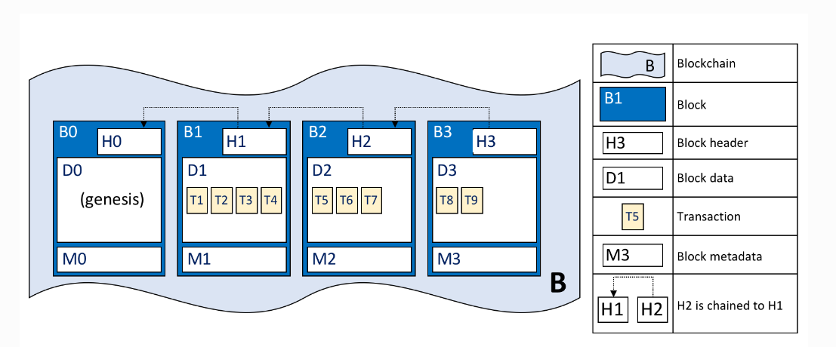
Block
It consists of three sections
Block Header This section comprises three fields, written when a block is created.
Block number: An integer starting at 0 (the genesis block), and increased by 1 for every new block appended to the blockchain.
Current Block Hash: The hash of all the transactions contained in the current block.
Previous Block Header Hash: The hash from the previous block header.
These fields are internally derived by cryptographically hashing the block data. They ensure that each and every block is inextricably linked to its neighbour, leading to an immutable ledger.
 | BCDV 1025 Enterprise Blockchain | Pratik Patil

Slide 20
Block
Block header details. The header H2 of block B2 consists of block number 2, the hash CH2 of the current block data D2, and the hash of the prior block header H1.
Block Data This section contains a list of transactions arranged in order.
Block Metadata This section contains the certificate and signature of the block creator which is used to verify the block by network nodes. Subsequently, the block committer adds a valid/invalid indicator for every transaction into a bitmap that also resides in the block metadata, as well as a hash of the cumulative state updates up until and including that block, in order to detect a state fork. Unlike the block data and header fields, this section is not an input to the block hash computation.
 | BCDV 1025 Enterprise Blockchain | Pratik Patil

Slide 21
Orderers
Orderers are the nodes in the network responsible for batching the transaction in a block
The configuration of the Orderer is stored in the file orderer.yaml
Orderer forms a set of transactions and cryptographically links it to the preceding block(s) on a channel.
Orderers also enforce basic access control for channels, restricting who can read and write data to them, and who can configure them.
Orderer also processes the configuration transactions.
The configuration of the orderer is stored in a file orderer.yaml
Orderer needs a Genesis block to start with.
The Genesis block can be generated with cryptogen utility by importing the config from
crypto-config.yaml
 | BCDV 1025 Enterprise Blockchain | Pratik Patil

Slide 22
Types of Orderers
Raft (recommended)
Raft is a crash fault tolerant (CFT) ordering service based on an implementation of Raft protocol. Raft follows a “leader and follower” model, where a leader node is elected (per channel) and its decisions are replicated by the followers.
Kafka (deprecated in v2.x)
Similar to Raft-based ordering, Apache Kafka is a CFT implementation that uses a “leader and follower” node configuration. Kafka utilizes a ZooKeeper ensemble for management purposes
Solo (deprecated in v2.x)
The Solo implementation of the ordering service is intended for testing only and consists only of a single ordering node. It has been deprecated.
 | BCDV 1025 Enterprise Blockchain | Pratik Patil

Slide 23
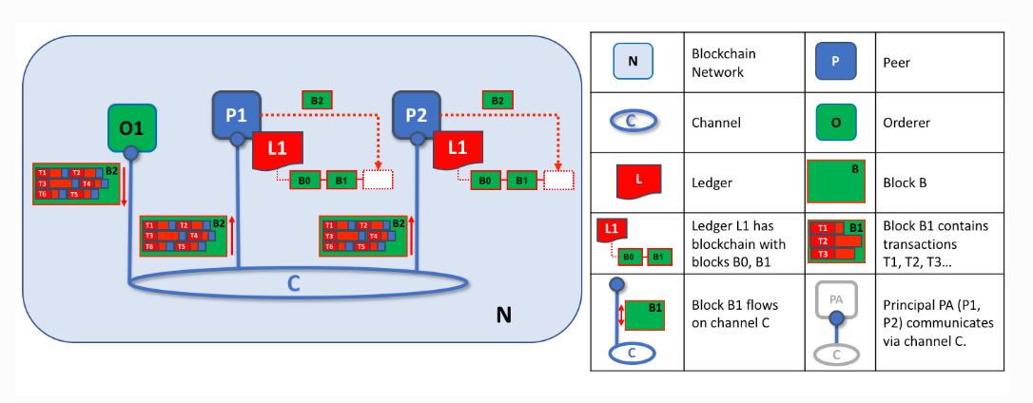
 | BCDV 1025 Enterprise Blockchain | Pratik Patil

Slide 24
Different Environments to run Hyperledger Network
Baremetal
Appropriate Binaries need to be downloaded
Prerequisite of Golang.
Configuration needs to be stored in core.yaml for peers and orderer.yaml for orderers.
2. Docker
Can be run using the prebuilt Docker images
Environment variables can be set to overwrite the default configuration.
Custom images can be built by importing the custom configuration files
Easy to setup
Requires a Docker Daemon access
Only used in the Test- Environment
3. Kubernetes
Used for the Production deployment
Configuration same as the Docker
Requires a Load Monitoring
Credentials/ Identities cab be secured using Secrets
A Statefulset can be deployed for each entity
 | BCDV 1025 Enterprise Blockchain | Pratik Patil

